Slide 1
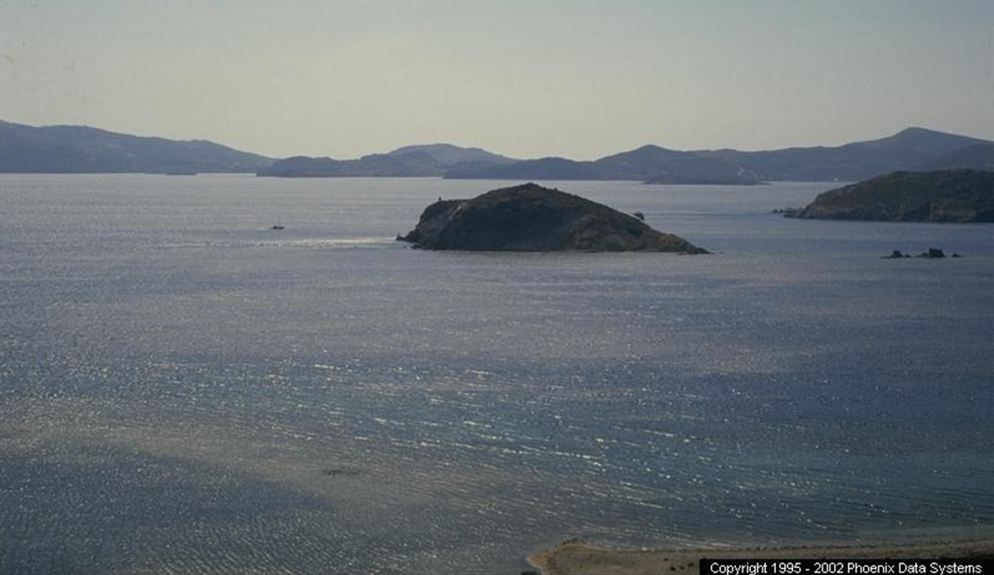
Jesus vs. Christianity, Inc.
But he laid his right hand on me and said, “Don’t be afraid! I am the First and the Last.”
Revelation 1:17
Revelation 2-3
Notes:
Patmos → Barren Rock=Hopeless/Old Age
** “~B Afraid…”

Slide 2
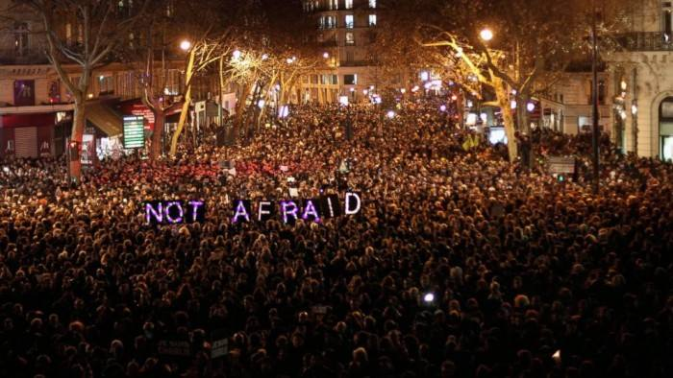
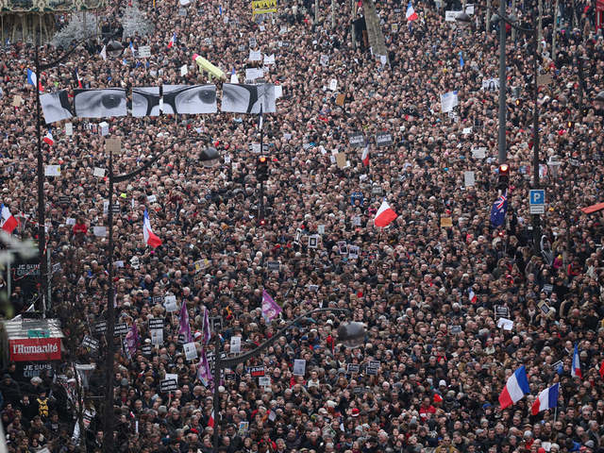


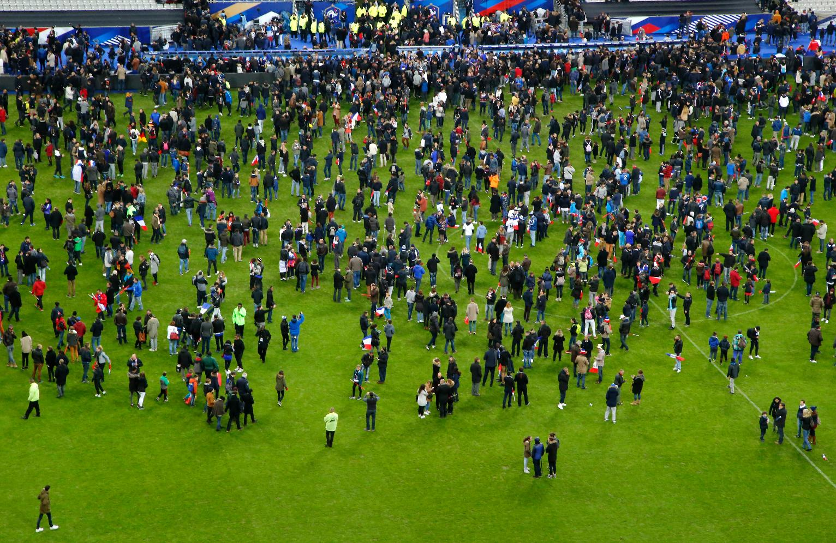

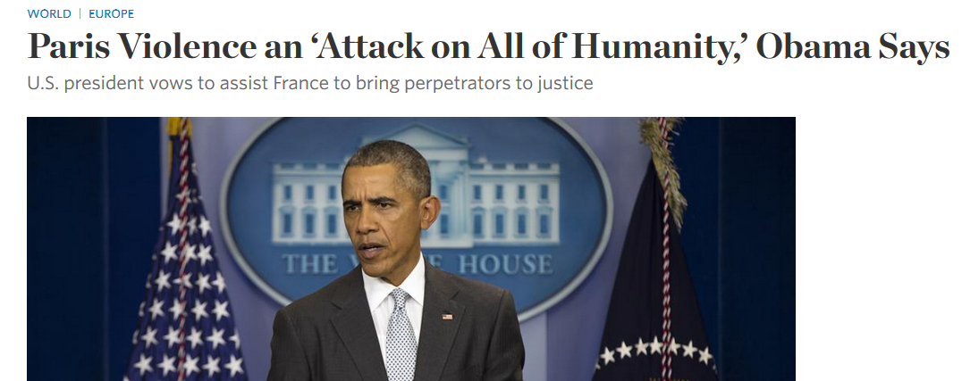

World in Confusion
An attack against our Universal Values
Notes:
=Gud Msg 2Dy: ** Terror → ** 1/2015 = Masses ** ~Afraid!
** Je Suis = Jesus?? ** Last Night
** “All Humanity” b/c → “Univ.Values” ?!
→ These Guys R WRONG! (??) → ~72 Virgins!!
** Now “PRAY” = Secular News Prog. → G=Answers!
~1 Cares Re:G UNTIL→Chaos, Death → Every1=DIES!

Slide 3



World in Confusion
“Don’t be afraid! I am the First and the Last.” Revelation 1:17
Notes:
PBS=Last Night → **Terror in Paris, 120 Ppl Killed, Chaos, Etc.
** Micro-Aggression = “Most Serious Harm!” → REALLY!?
=Secular Wisdom → Real Answers? → FRAGILE Answrs
** Micro-Punishments=Solve ANY Problems?
** JC=REAL Solutions, REAL Person, REAL History
AP: Thanksgv → ~Black Fri → Talk Re: JC →B Educated!

Slide 4
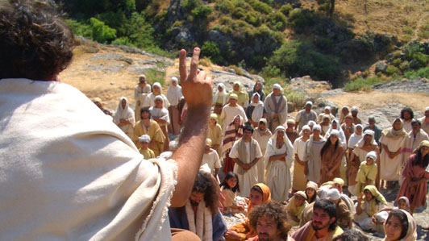
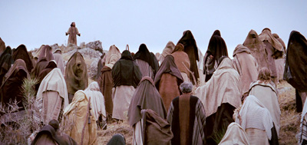
Jesus: “I Am the First & the Last”
Mark 11:18 The chief priests and the teachers of the law heard this and began looking for a way to kill him, for they feared him, because the whole crowd was amazed at his teaching.
John 7:45-46 When the Temple guards returned without having arrested Jesus, the leading priests and Pharisees demanded, “Why didn’t you bring him in?” “We have never heard anyone speak like this!” the guards responded.
It Changed
Matthew 7:28-29 When Jesus had finished saying these things, the crowds were amazed at his teaching, for he taught with real authority—quite unlike their teachers of religious law.
Notes:
JC=Changed History → OWNS History → AP: KNOW Hist!
** JC=Threat 2 Status Quo, Powers That BE
** “Peace, Baby!”
** Even GUARDS Impressed=2Day=Every1 “Respects” JC
**~Religious Teachers → ~Religion →Relationship
** CHNGED → Relig!! → EMPTY Chrch→ AP:U=Explain?

Slide 5
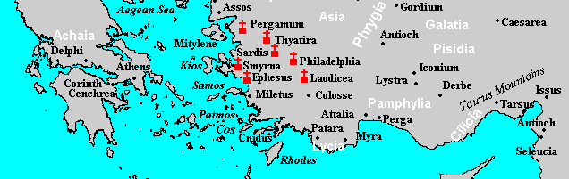
What Changed? “The 7 Churches of Asia”
Revelation 1:11 “Write what you see in a book and send it to the seven churches, to Ephesus and to Smyrna and to Pergamum and to Thyatira and to Sardis and to Philadelphia and to Laodicea.”
1st Century
Church Age?
Rev.1:1 The revelation of Jesus Christ, which God gave him to show to his servants the things that must soon take place…
Rev.1:3 Blessed is the one who reads the words of this prophecy…
Notes:
Chng=7 Churches **Explains → **REAL, Turkey, P’s Churches
**1st C ^ Future? ← **1:1=“Future” **v.3 =“Proph”

Slide 6
What Changed? “Christianity, Inc.”
A Prophetic Book
Why These 7?
“Complete Church Age”
Corresponds Tightly
Revelation 1:11 “Write what you see in a book and send it to the seven churches, to Ephesus and to Smyrna and to Pergamum and to Thyatira and to Sardis and to Philadelphia and to Laodicea.”
Notes:
Chng= “Xianity Inc” ** #1=Clock Hands →j.k.
** 1) Claims 2b Prophetic ** 2) Scores Ch’s→Only 7
** 3) 7= “Completion” ~Disagreem ** 4) Corresp
AP: =Effective Witness 2 Knw Ch.Hist.

Slide 7
What Changed? “Christianity, Inc.”
Tons of “Church History” Warnings in Scripture!
1 Timothy 4:1-4 But the Spirit explicitly says that in later times some will fall away from the faith, paying attention to deceitful spirits and doctrines of demons, by means of the hypocrisy of liars seared in their own conscience as with a branding iron, men who forbid marriage and advocate abstaining from foods which God has created to be gratefully shared in by those who believe and know the truth. For everything created by God is good, and nothing is to be rejected if it is received with gratitude;
Matthew 23:9 "Do not call anyone on earth your father; for One is your Father, He who is in heaven.
INCLUDING: Rev. 2 -3
Notes:
=Why Ppl ~Allowed 2 OWN BIBLE

Slide 8
What Changed? “Christianity, Inc.”
there is not the slightest hint in the text that the seven churches are to be understood in such a way…
Except, of course, it is declared a book of prophecy!
In fact, it is only a very forced and erroneous reading of church history can make it appear as prophecies.
Will a natural/correct reading of church history change your mind?
Again, there is absolutely no hint in the text that John intended for us to understand these seven letters in that way.
If you repeat it enough times, it must be true!
From Holman Bible Commentary
Notes:
Direction=Clock Hands →j.k.

Slide 9
What Changed? “Christianity, Inc.”
Solution to the “7 Churches”
Let’s pretend there’s no prophecy
Can I use them to illustrate church history?
Let’s admit they were real, 1st C Churches
Notes:
Illustrate = HOLMAN POLICE Bust in & arrest me??
Is it FAIR? → YES
(Isn’t it AMAZING that I can?)

Slide 10
Christianity, Inc: Ephesus
Revelation 2:1 “To the angel of the church in Ephesus write: ‘The words of him who holds the seven stars in his right hand, who walks among the seven golden lampstands.”
Revelation 1:20 "As for the mystery of the seven stars which you saw in My right hand, and the seven golden lampstands: the seven stars are the angels of the seven churches, and the seven lampstands are the seven churches.
The Angel
Heb. 1:14 angels are only servants—spirits sent to care for people who will inherit salvation.
Jesus
Walks among us: “I will build My church…” (Matt. 16:18)

Slide 11
Christianity, Inc: Ephesus
If the Jesus Van’s-a-Rockin’…
Revelation 2:2 'I know your deeds and your toil and perseverance, and that you cannot tolerate evil men, and you put to the test those who call themselves apostles, and they are not, and you found them to be false;
‘Post-Apostolic’ Age
TONS of Itinerate, Wandering “Preachers”
2 Cor. 3:1 Are we beginning to commend ourselves again? Or do we need, as some, letters of commendation to you or from you?
Notes:
**Post-Apostolic=Marked by ** Itinerate Prch
= ** Jesus RV! ** Remember!!
** 1Co.3=Already Beginning

Slide 12
Christianity, Inc: Ephesus
Revelation 2:3 and you have perseverance and have endured for My name's sake, and have not grown weary.
Tough
Fruitful
Acts 20:29-30 "I know that after my departure savage wolves will come in among you, not sparing the flock; and from among your own selves men will arise, speaking perverse things, to draw away the disciples after them.
Notes:
**Tough=Endured Riots/Opposition
Temple Diana=7 Wonders World
**Acts 20=Src of Xianity, Inc. → Internal Wolves? Hrd 2 Blv!
AP: Nd.Every Xian On-Guard/INVEST, ~Jst “Elite”
EPH=Successful @Defending Against→JC Praises
**Fruitful=LARGEST of P’s Churches → Spread “throughout Asia”

Slide 13
Christianity, Inc: Ephesus
Revelation 2:4 ‘But I have this against you, that you have left your first love.’
Revelation 2:5 'Therefore remember from where you have fallen, and repent and do the deeds you did at first; or else I am coming to you and will remove your lampstand out of its place—unless you repent.
Lampstands
Where JC Walks
“You are the light of the world”
Notes:
BUT! So serious… ** Rmv.Lamp=**JC Walks
=JC’s Work-Area → JC ~Wrk **Light..World
AP: Catholic Church ~ONLY PLACE
AP: Neo-Xenos ~Guarantee=IRELEVANT

Slide 14
Christianity, Inc: Ephesus
1st Love
Lo Impact
Church, Inc.
Meeting JC
JC’s love for you
‘Love Defect’
Hard-Working, Loyal
BORING – RIGID
Selfish, Tribal
Uncompassionate
Critical, Divisive
Notes:
Lose 1st Luv → **Lo Impact: ~Grwth, Irrelevant, BORING
** Inc.=Hire Ppl 2 Wrk (=Boring!)
** =Meet JC→ Luvs U → Chng.Evryth!
IL: Boy/Girl 1st Date=Zombie Smiles →Motivated
→ 10 Yrs Later → FORGOT!!
→GOSP: ~Meet Church, Inc., → Meet JC
** Work-Subs

Slide 15


Christianity, Inc: Ephesus
Solutions (v.5)
Remember
Repent
Do the deeds you did at first
John 4:23 …true worshipers will worship the Father in spirit and truth, for the Father is seeking such people…
Notes:
Solut= **1) Remember “fwhere ..fallen” \ MOM: “Evryth Wrks Out”
AP: ??Like 2b w/o G? =**Confus / Anxiety / ~FUTURE
**2) Repent=Go Bk 2 JC→**Honest Talk=Gud State Jn.4:23
=TELL OTHS → Ask 4 HELP → ~B Tuff Guy
**3) DO “@1st” → B. Lights …world → **Terror/**Confusion
=ENGAGE Outside! Pay Attention! →COMPASS! Give!
@Thanskgiving → SPEAK, for cryin out lout

Slide 16
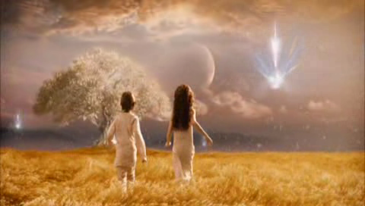
Christianity, Inc: Ephesus
Revelation 2:6 Yet this you have: you hate the works of the Nicolaitans, which I also hate.
Revelation 2:7 He who has an ear, let him hear what the Spirit says to the churches. To the one who conquers I will grant to eat of the tree of life, which is in the paradise of God.’
1 John 5:4 this is the victory that has overcome the world—our faith.
Notes:
Nocolaitans=NXT WK=Priest/Clergy (“hire some1 else”)
** Conquer=**Ur FAITH=That SIMPLE=Relat.w/JC
GOSP: Issue=??Willing 2b Forgiven?? → **Tree=1 Choice

Slide 17
The 7 churches: what are they?
Notes:
Anti-Futurist Rap:
Holman Bible Commentary: there is not the slightest hint in the text that the seven churches are to be understood in such a way. In fact, it is only a very forced and erroneous reading of church history that can make the letters to the seven churches appear as prophecies. (Except, of course, it is declared a book of prophecy!) …[so] we read Revelation in the same general way that we would read Paul’s letters to the Corinthians. Rev 2:1 (SORRY! This is not, first and foremost, a doctrinal treatise!) Again, there is absolutely no hint in the text that John intended for us to understand these seven letters in that way. (If you repeat it enough times, it must be true!)
Expositors: This futurist approach has enjoyed a revival of no small proportion since the nineteenth century (because, of course, it’s beginning to make sense to us) and is widely held among evangelicals today. The chief problem with it is that it seems to make all but the first three chapters of Revelation irrelevant to the contemporary church. (Yes, unless you want to say the church = Israel.) This objection is pressed more strongly when adherents to the futurist view affirm, as many do today, that the church will be removed from the earth before the events described in 6:1ff. occur.
Bible Knowledge Commentary: There are some remarkable similarities in comparing these letters to the seven churches to the movement of church history since the beginning of the apostolic church. For instance, Ephesus seems to characterize the apostolic church as a whole, and Smyrna seems to depict the church in its early persecutions. However, the Scriptures do not expressly authorize this interpretation, and it should be applied only where it fits naturally. After all, these churches all existed simultaneously in the first century. The Bible Knowledge Commentary: An Exposition of the Scriptures by Dallas Seminary Faculty. Expositor's Bible Commentary Abridged, The - – The Expositor's Commentary - Abridged Edition: New Testament.

Slide 18
“Lost their first love…”
See Luke 10:20 –"Behold, I have given you authority to tread on serpents and scorpions, and over all the power of the enemy, and nothing will injure you. "Nevertheless do not rejoice in this, that the spirits are subject to you, but rejoice that your names are recorded in heaven."
Notes:
Re: Lk.10;20 Jesus cautions the seventy. He tells them that even though He has given them great power, a still more precious gift is theirs. They are loved eternally. Some day the world will pass away. They will all die. All these marvelous events that thrill them now will some day be inconsequential. The eternal fact is that their names are written in the Lamb's Book of Life and they will live eternally—home free forever and ever. That assurance is the real source of joy. Incidentally and temporally they had great power. Preacher's Commentary, The - The Preacher's Commentary – Volume 26: Luke.
Jesus "rejoiced" upon hearing this news. This is the only place where this particular word is used to describe Jesus' emotions. He is beside Himself with joy when He hears their report. It's mind-boggling to realize that we have the power to make God rejoice by our fruitful ministry. It was the beginning of a whole new day. Up to that point, the battle was between Satan and Jesus. Because of the works of the seventy, Satan experienced a mighty fall. Jesus says, "I saw Satan fall like lightning from heaven." Preacher's Commentary, The - The Preacher's Commentary – Volume 26: Luke.
it was the start of a new era. It was the beginning of the royal priesthood that Jesus has created to do His work in the world. Preacher's Commentary, The - The Preacher's Commentary – Volume 26: Luke.
The Lord cautioned them not to "go on rejoicing" over their victories but to rejoice because their names had been written in heaven. (The verb means "they have been written and they stand written." It is a statement of assurance. See Phil. 4:3; Rev. 20:12-15.) As wonderful as their miracles were, the greatest miracle of all is still the salvation of a lost soul. The Greek word translated "written" means "to inscribe formally and solemnly." It was used for the signing of a will, a marriage document, or a peace treaty, and also for the enrolling of a citizen. The perfect tense in the Greek means "it stands written."
But our highest joy is not found in service or even in our salvation, but in being submitted to the sovereign will of the Heavenly Father, for this is the foundation for both service and salvation. Here we see God the Son rejoicing through God the Holy Spirit because of the will of God the Father! "I delight to do Thy will, O my God" (Ps. 40:8) Bible Exposition Commentary (BE Series) - New Testament - The Bible Exposition Commentary – New Testament, Volume 1.

